Slide 1
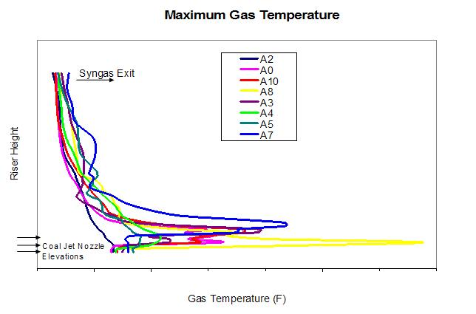
a) what’s the value proposition for accurate and fast multiphase flow modeling via an example or two
Increase the confidence in scale up, so that larger scales can be reached faster
Reduces the cost and time of technology development
Troubleshoot or optimize existing designs
Reduce the cost of redesign
Reduce downtime of the plant
MFIX simulations were used to evaluate the performance of a 285 MWe gasifier involving 50X scale up by Southern Company/KBR
MFIX simulations were used to troubleshoot a nuclear waste cleanup reactor, which helped Fluor Idaho to evaluate design changes and redesign the reactor
Examples courtesy of C. Guenther, NETL
Notes:
Sofiane
We should be very honest in saying exactly what it took to do this work. How long did this studies take and at what cost? We're still far from conducting fast and accurate simulations. We can't do it by ourself. We need industry not only to use these tools and tell us how to improve them, but we need them to actively participate in the development/V&V of these numerical tools. We won't get far from the active participation of industry, academia and national labs.
Yupeng
CFD is complicated, it needs knowledge (both physical, numerical, programming), it needs resource (researchers and HPC) and it needs time (very time consuming) and so on, which inhibits the use among industries.
We have the ability and the resource to do these things, but currently we are only working on very small or even tiny scale simulations. Although we do both experiments and simulations, mostly cold flows, we are away from the real scale applications. We need real application case closely related with the industries (detailed problem, experimental results etc) to not only validate our large scale models (TFM, MPPIC and CGPM) , but also really help them. In short, we should be real application oriented.
I am not sure if the industries would like to provide the funding and also share these intellectual things (setup details and real problems) with us. How can we help them while not offend their intellectual properties. I think we are ready to help them.

Slide 2
b) current challenges
Proposing a CFD project
Negative perceptions about unreliability of CFD (not unique to multiphase flow)
“Colorful fluid dynamics”, “Cartoon fluid dynamics”, “CFD is for PhDs”
Lack of customer awareness of the value; e.g., “Why use CFD when much faster process simulations exist?”
Conducting CFD simulations
Analysts with much multiphase CFD expertise are required
Lack of accurate physical models; e.g., TFM cannot handle packed regions or particle size distribution
Large time-to-solution; e.g., a one-day turn around time is currently not feasible
Lack of data required for sub-model validation or calibration
Uncertainty in the results of predictive simulations is not known
Application projects may veer off to a research project, much to the consternation of the customer
Communicating and applying simulation results
Difficulty in communicating results to engineers that operate the unit or are working the redesign
When the simulations successfully impact the design how do we estimate the value added by simulations?
Advancing capabilities
How do we articulate the critical need for funding required to advance the capabilities?
Notes:
Justin
Lack of awareness of the value of CFD simulations is a big challenge. The amount of data available from modern CFD simulations is enormous, and I think a lot of engineers don’t know what questions to ask when they have a CFD result. Hence, the perception that all we get from CFD is pretty pictures.
On the flip side of this, I might add, “lack of awareness of limits of CFD”. As with any tool, there are good uses of CFD and bad uses of CFD. Pulling out the CFD war chest when its not actually needed (ie, process models/theory are available to obtain the same answer), or will result in a very inaccurate solution (ie, applying models outside their domain of applicability) can make some managers/engineers cynical about its value as a design tool.
Dave
Proposal Stage
Not clear when to use CFD and when to use other tools ?
Execution Stage
Use of generic sub-models and/or material properties increases the uncertainty in the predictions. This uncertainty could be reduced with measurement and/or calibration of the associated sub models. For example drag using fluidization test, stress/viscosity using rheological experiments or static/frictional pressure vs. volume fraction using a compaction test.
The distinction between calibration and prediction (validation) is not necessarily well understood.
T.G. Trucano, L.P. Swiler, T. Igusa, W.L. Oberkampf, M. Pilch, Calibration, validation, and sensitivity analysis: What's what, Reliability Engineering & System Safety, Volume 91, Issues 10–11, 2006, Pages 1331-1357, https://doi.org/10.1016/j.ress.2005.11.031. https://www.sciencedirect.com/science/article/pii/S0951832005002437
Section 2.2 - “A situation like Fig. 3 demonstrates the potential confusion of calibration with validation. In other words, a decision might be made to adjust certain parameters in the calculations to improve the agreement of ALEGRA (or any code undergoing this kind of comparison) with the presented experimental benchmark(s). A common example of this is the choice of a mesh when a calculation is otherwise not converged.”

Slide 3
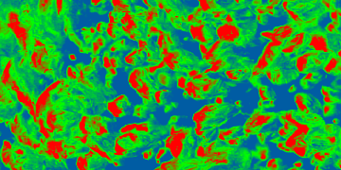
c) path/approach to realize this potential
Outreach to engineers/managers that are end users of multiphase CFD
Listen carefully to customers; define the problem objectives well; set clear customer expectations
Communicate with design or operating engineers as often as possible
High-level development needs are clear: develop a suite of tools that vary in cost vs accuracy, reduce time-to-solution, increase accuracy of physical models, collect accurate data for validation/calibration, and estimate the uncertainty in predictive simulations
Is it time for an MFDRC-II, spearheaded by the industry?
Multiphase Fluid Dynamics Research Consortium¹
Funded by DOE-Office of Industrial Technologies, 1998-2003
Led by industry: ChevronTexaco, Dow Chemical, Dow Corning, DuPont, ExxonMobil, and Millennium Chemicals
Participants included Fluent, AEA Technology, CPFD, seven universities, and six national laboratories
Outcome: Improved CFD codes, developed novel models, developed a scientific community (trained 22 postdocs, touched over 200 professionals)
The purpose will be to build a scientific community (industry, universities, national labs, and funding agencies), raise visibility, define problems relevant to industry, and set clear and achievable goals
MFDRC
1. Lyczkowski RW. The History of Multiphase Science and Computational Fluid Dynamics. Springer, 2018.
Notes:
Dave
It is clear that we need to reduce time-to-solution, increase accuracy of physical models, and estimate the uncertainty in predictive simulations
To the list I would also add:
robustness/reliability/stability of the computational algorithms
guidance on sub-model selection
guidance on sub-model calibration and material characterization experiments
simulation cost estimates
suites of tools/approach which vary in cost and accuracy allowing end-user to select a solution based on the project scope
In multiphase fluidization there seems to be a “hole” where steady RANS models would fit in the context of single phase flow or dilute multiphase flow.

